Slide 1
Indigenous Economic Priorities
APEC Business Advisory Council
Presentation by Rachel Taulelei, ABAC NZ
MSMEIWG
April 2022
www.abaconline.org

Slide 2
Indigenous in APEC
APEC Putrajaya Vision – for the prosperity of all our people and future generations
Indigenous = 260 million people – 70% of the global Indigenous population
Indigenous businesses confront a range of historical and contemporary structural disadvantages, on top of the challenges that any other MSME would face.

Slide 3
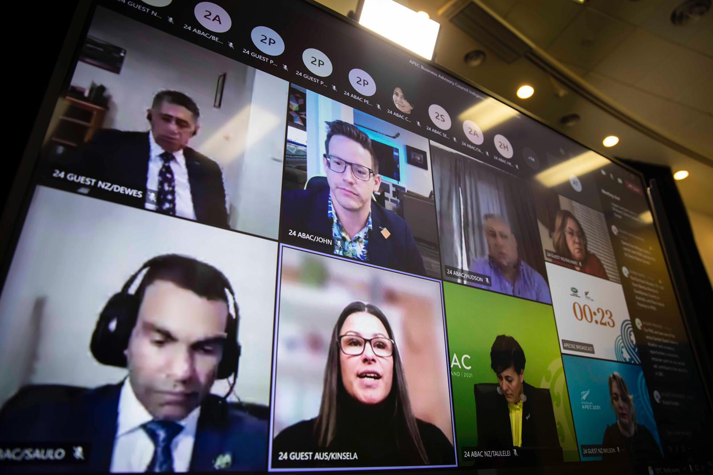
Indigenous Business Leaders Dialogue (July 2021)

Slide 4
Statement of Priorities
ensuring access to the resources necessary for wellbeing and economic security
stimulating and incentivising growth and scalability of Indigenous businesses
meeting infrastructure needs of rural and remote Indigenous communities
expanding the range of relevant data
exploring how Indigenous economies could benefit from trade agreements

Slide 5
Next steps
Future dialogues with Indigenous should start from the basis of the Statement of Priorities
“Uia mai ki a au, he aha te mea nui o te ao?
Mākū e kī atu, he tāngata, te tāngata, he tāngata !

