Slide 1
Climate Change
APEC Business Advisory Council
ABAC II 2022
Presentation by Malcolm Johns, Co-Chair
SWG II
27 April 2022
www.abaconline.org

Slide 2
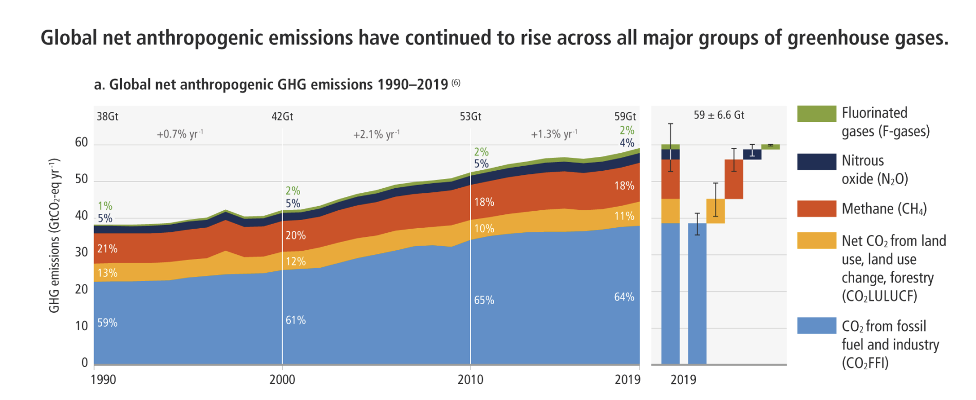
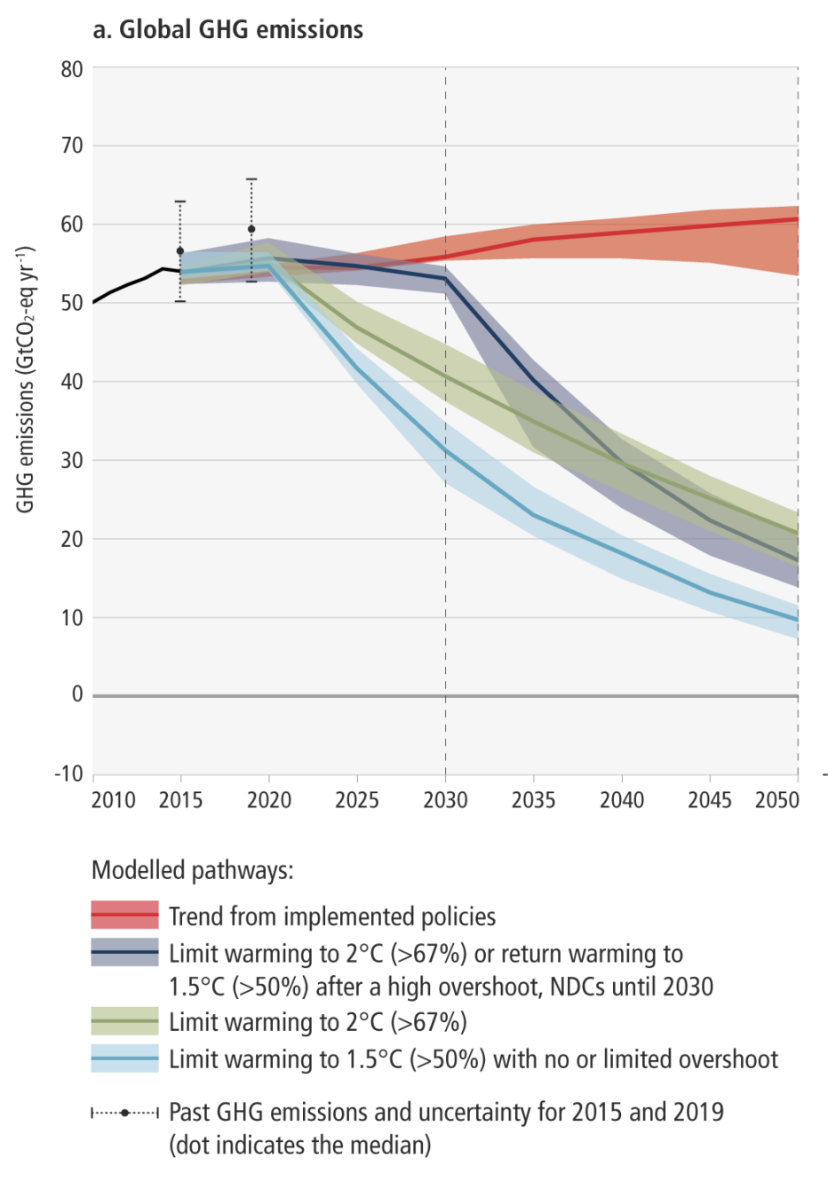
IPPC Report (April 2022)
Projected global GHG emissions from NDCs announced prior to COP26 make it likely that warming will exceed 1.5°C and make it harder after 2030 to limit warming to below 2°

Slide 3
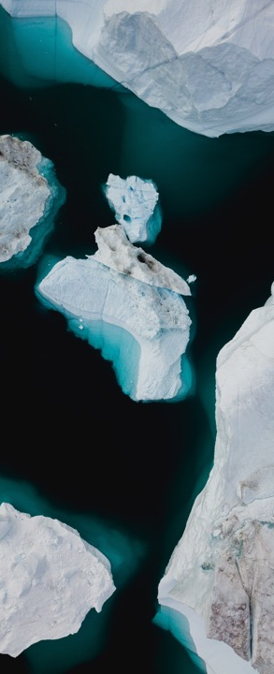
ABAC Climate Leadership Principles
Reduction
Businesses should play their part in the transition to a low-carbon region.
Actions include: measuring, monitoring, reporting GHG footprints, emissions reduction targets, decoupling from fossil fuels
Adaptation
Businesses should support behavioural and technological adaptation.
Actions include: risk assessment and management, ESG investing, championing low-carbon technology/ digitalisation
Just Transition
Businesses should seek sustainable and equitable transitions within open rules-based trade.
Actions include: building a just transition, challenging polarisation, supporting underserved communities
Photo by Annie Spratt on Unsplash.com

Slide 4
Focus for today
1. Reduction/Mitigation
Case study on CIAL
Decarbonisation of Industrial Sector
2. Adaptation
Framework on trade and investment in renewable energy
3. Just Transition (focus for ABAC III)
Focus on practical approaches to ‘just transitions’: How to address the relationship between climate change, inclusion and a low-carbon economy in the context of an open, rules-based trading system

Slide 5
CLIMATE CHANGE WORKSTREAM
Recommendations
Members to note today’s presentations.

